Slide 1

AllLife Bank – Project 7
Sarah A. Thomas

Slide 2
Business Problem Overview and Solution Approach
It has come to the attention of the bank through the Marketing Research team, that penetration in the market can be improved. The Marketing team would like to create new targeted campaigns. In addition, the Marketing team found that service is perceived poorly. Thus, the Operations team would like to improve service. Towards all these efforts, the Data Science team has created segmentation models through the K-Means and Hierarchical Clustering algorithms using Python.

Slide 3
Data Overview
Variable | Description
Sl_No | Serial Number – Primary key of the records
Customer Key | Customer identification number
Average Credit Limit | Average credit limit for each customer for all credit cards
Total Credit Cards | Total number of credit cards for each customer
Total Visits Bank | Total number of yearly visits in person to the bank made by the customer
Total Visits Online | Total number of yearly visits made online by the customer
Total Calls Made | Total number of calls made by the customer to the bank

Slide 4
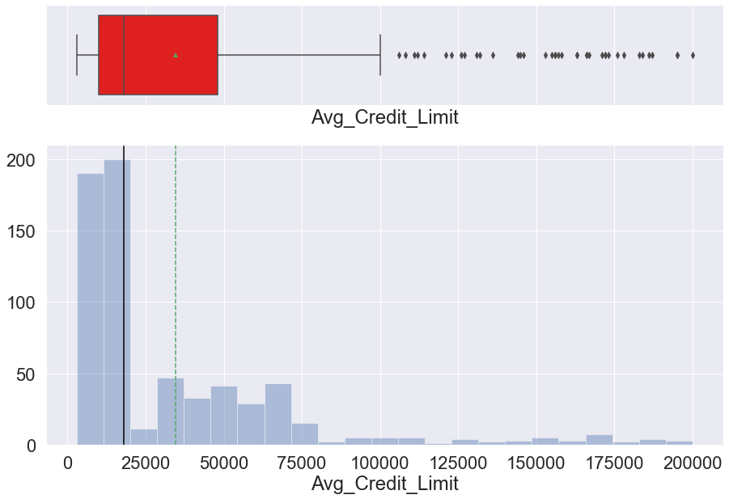
Avg_Credit_Limit
* Avg_Credit_Limit: Mean (34,574.24) is greater than median (18,000.00), indicating a right-skewed distribution.
* Outliers exist to the right and are treated.

Slide 5
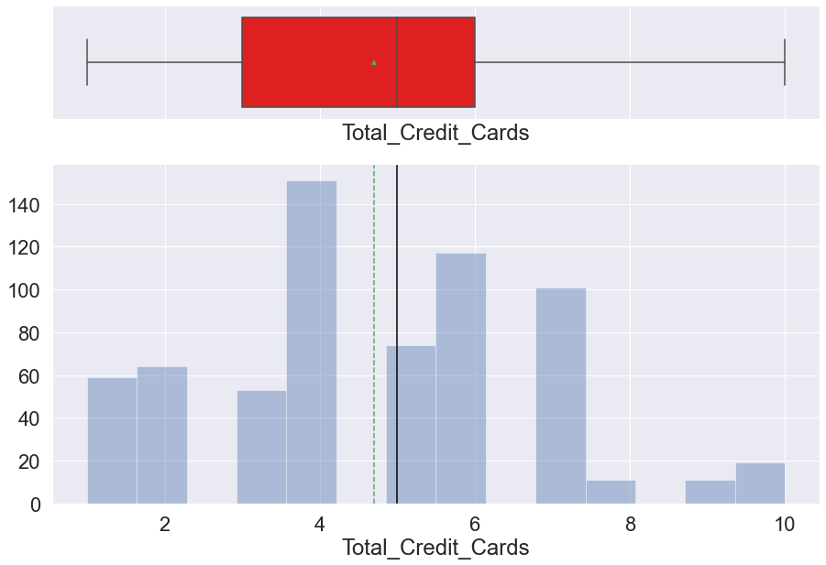
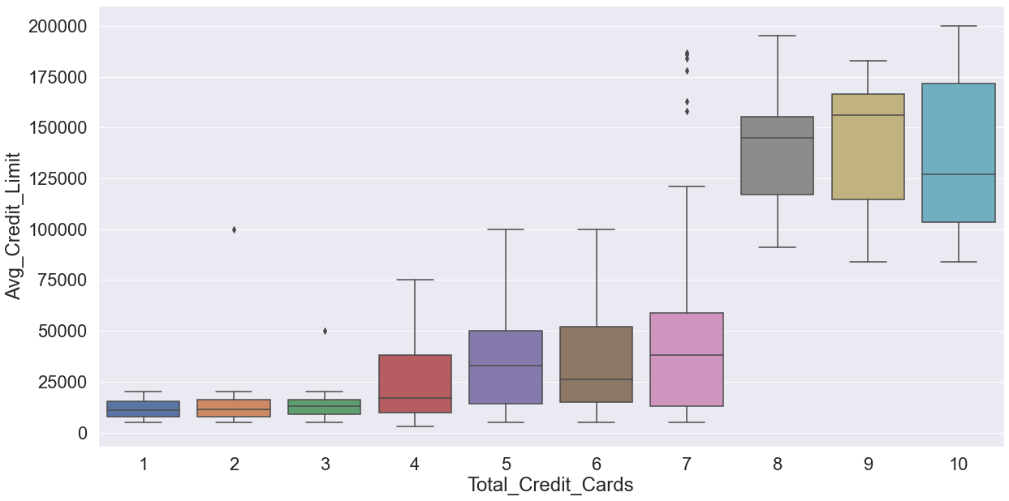
Total_Credit_cards
* Total_Credit_Cards: Median (5.0) is greater than mean (4.71), indicating a slightly left-skewed distribution.
* As would be expected, the average credit limit increases with the number of total credit cards.

Slide 6
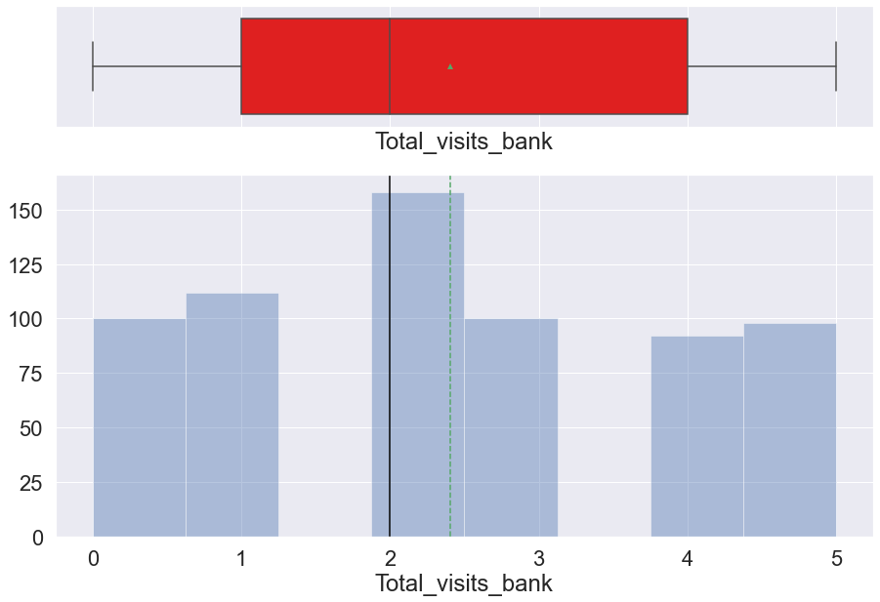
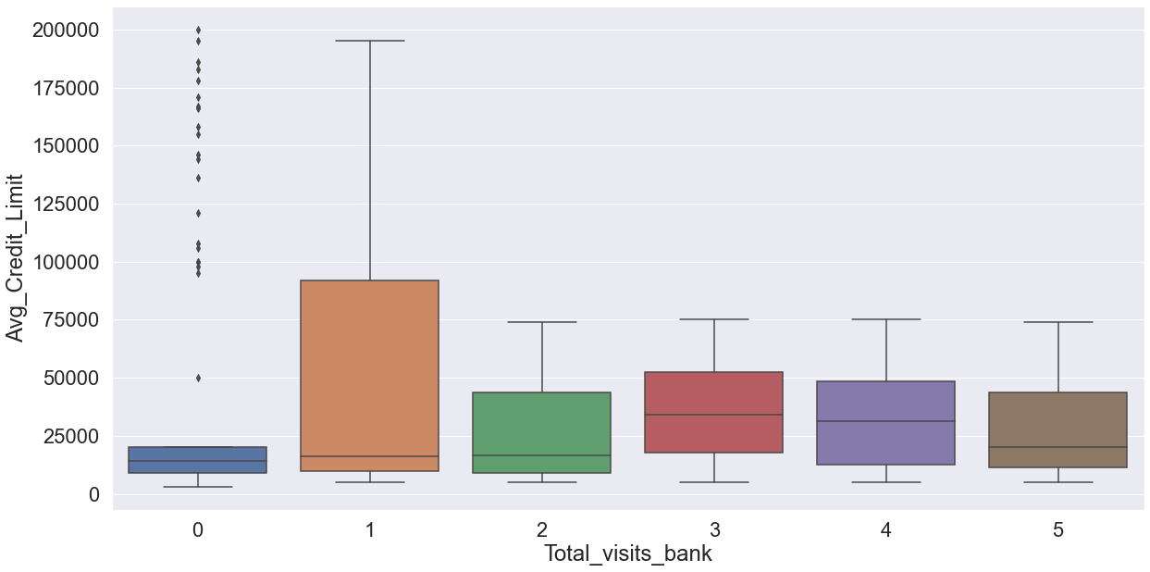
Total_visits_bank
Total_visits_bank: Mean (2.40) is greater than mean (2.0), indicating a right-skewed distribution.
Interestingly, those with higher credit limits visit the bank less.

Slide 7
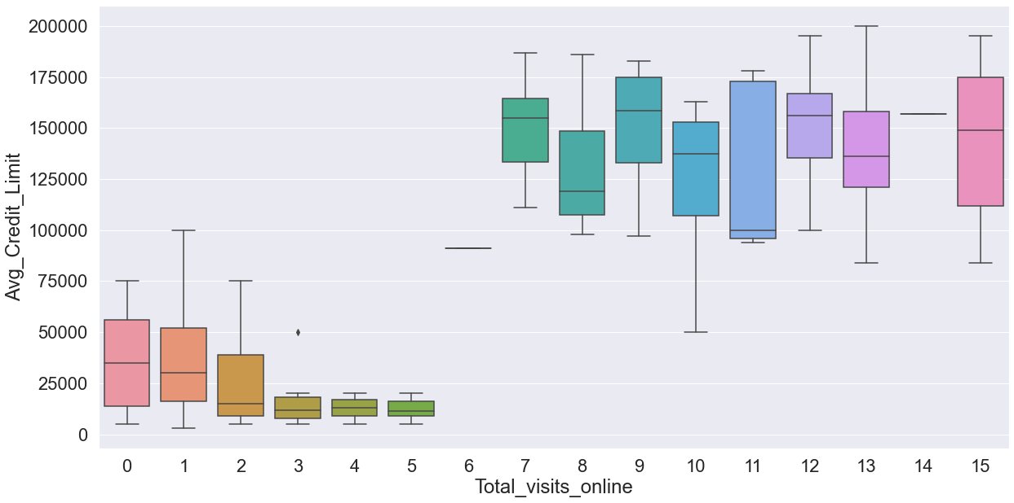
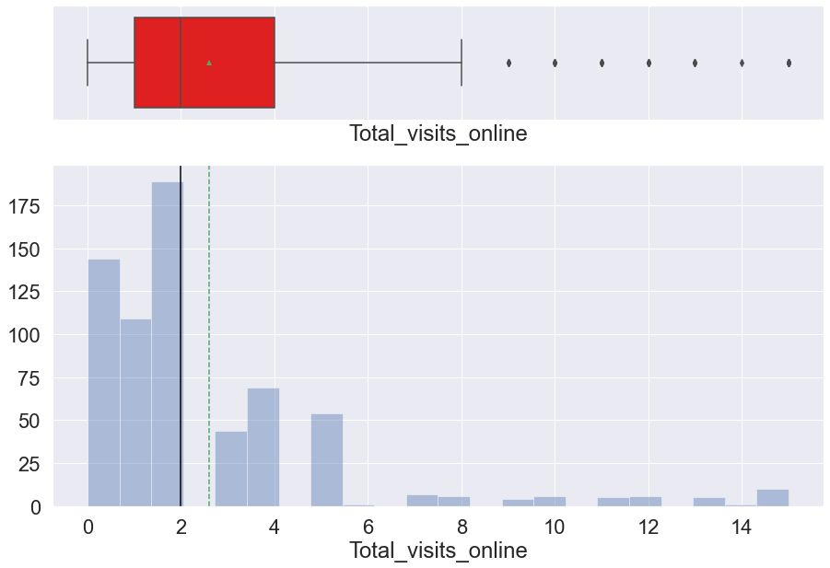
Total_visits_Online
* Total_visits_online: Mean (2.61) is greater than median (2.0), indicating a right-skewed distribution.
Outliers exist to the right but the values are close to the other values so are not treated.
Those with higher credit limits do online banking at a higher rate.

Slide 8
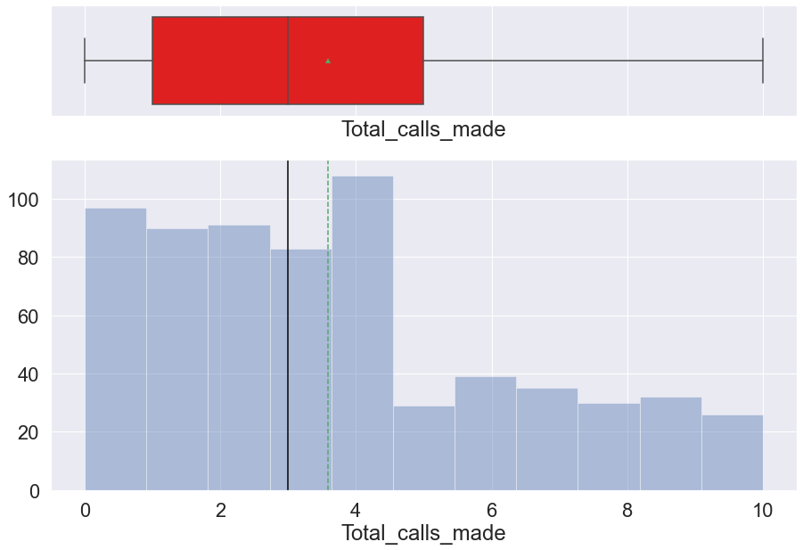
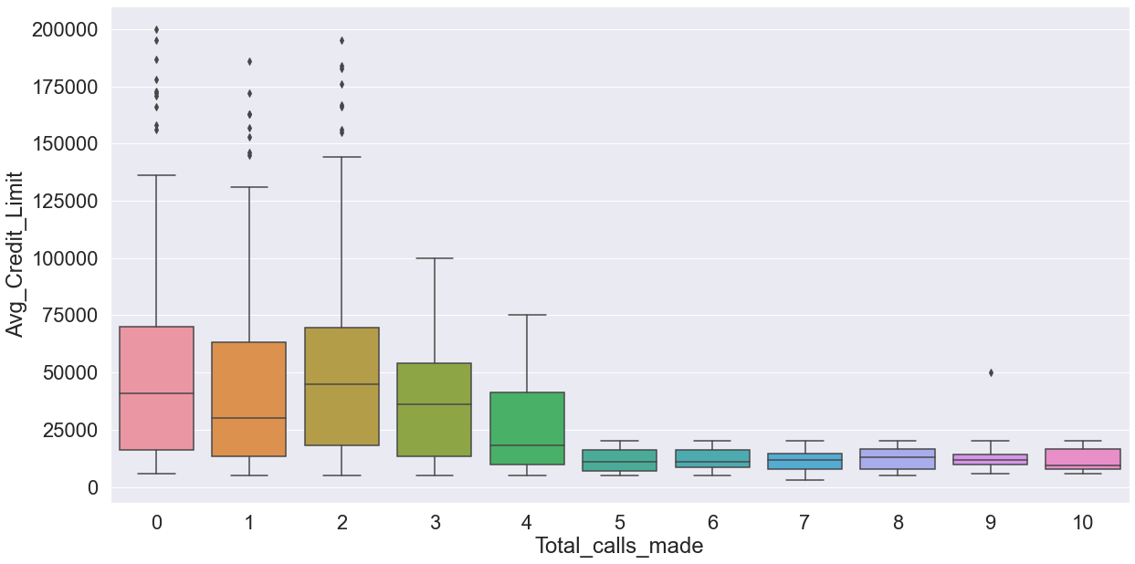
Total_Calls_Made
Total_calls_made: Mean (3.58) is greater than median (3.0), indicating a right-skewed distribution.
Those with lower credit limits made more calls to the bank.

Slide 9
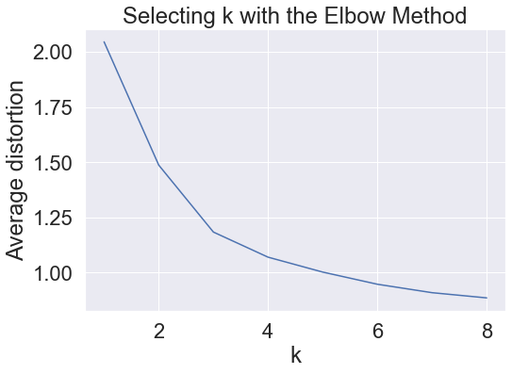
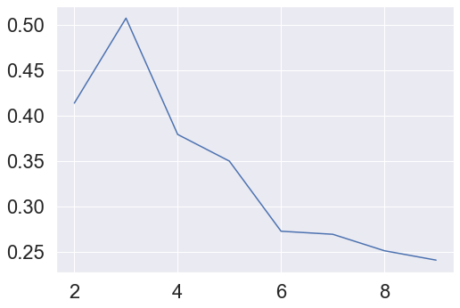
K-Means Clustering
Silhouette Scores
Based on the Elbow Method and Silhouette Scoring, we chose 3 as the number of clusters.

Slide 10
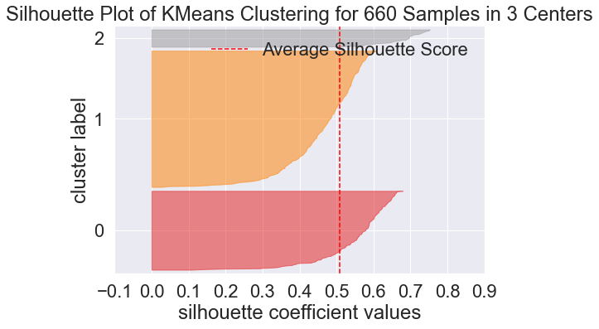
K-Means Clustering

Slide 11
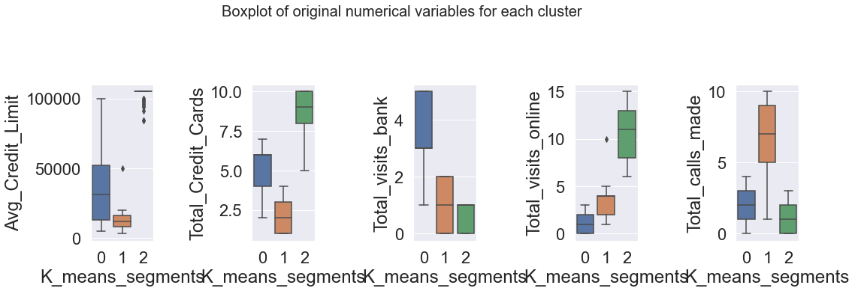
K-MEANS Cluster Profiling

Slide 13
Hierarchical Clustering
After viewing dendograms, we chose the Ward linkage method and 3 clusters.

Slide 14
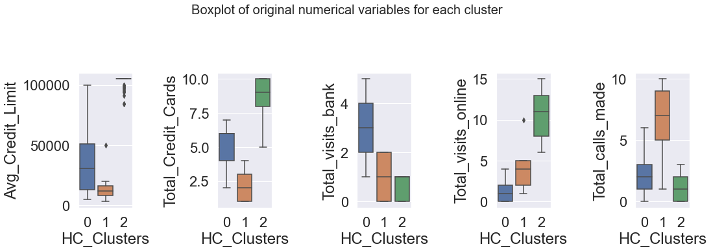
Hierarchical Cluster profiling

Slide 16
Business Recommendations
Note: Since the insights from both clustering techniques were practically identical, the clusters below may reference either clusters from K-Means or Hierarchical clustering.
First, we can summarize our customer segmentation in terms of service calls and credit card limit/number of credit cards as follows:
Cluster 0 represents the customers who make the most in-person visits to the bank (middle range in terms of credit limit and number of credit cards).
Cluster 1 represents the customers who make the most calls but have the lowest credit limits (and lowest number of credit cards).
Cluster 2 represents the customers that make the most online visits and have the highest credit limits (and highest number of credit cards).
Ideally, we would want customers to convert to Cluster 2 so that they have higher credit limits/credit cards and thus usage that can be more profitable for the bank. Some recommendations:
Incentivize seeking support online vs. in person or on the phone by ensuring that online account registration is (1) easy and convenient, (2) and perhaps add promotions for online users such as discounts at local merchants/restaurants or bonus point programs.
Ensure that when customers utilize phone or in-person support, they are informed of the online support option.
At this time, most customers fall into Clusters 0 (394) and 1 (216). Recommendations for improving service:
For all modes of support (online, in-person, phone), ensure that staff are properly and extensively trained.
For all modes of support (online, in-person, phone), ensure that staff are upselling services - possibly incentivize this for staff by offering rewards for certain number of services sold.
In-person and phone visits: reduce wait times for service by ensuring enough staff are scheduled for busier times of day - may need to do an analysis to determine which times of day are busiest.
Phone support: the customers who seek this option the most (Cluster 2) have the lowest number of cards - upselling/marketing is especially important for these customers.

